Slide 1
Chapter 14
Network Threats
and Mitigation

Slide 2
Objectives
Identify common security threats and mitigation techniques

Slide 3
Recognizing Security Threats
Although viruses are common threats that we hear about all the time, there are many other nasty things out there as well. Bad guys who create threats to a network generally have one of two purposes in mind: destruction or reconnaissance. They’re seeking to destroy data or deny access, and maybe even nick information that you definitely don’t want them to have. Some types of attacks can accomplish both, but they’re usually combinations of simpler forms.

Slide 4
Denial of Service (DoS)
A denial of service (DoS) attack does exactly what it sounds like it would do—it prevents users from accessing the network and/or its resources.
Even though DoS attacks are nasty, strangely, hackers don’t respect other hackers who execute them because they’re really easy to deploy.
DoS attacks come in a variety of flavors.

Slide 5
Viruses
In their simplest form, viruses are basically little programs that cause a variety of very bad things to happen on your computer, ranging from merely annoying to totally devastating. They can display a message, delete files, or even send out huge amounts of meaningless data over a network to block legitimate messages. A key trait of viruses is that they can’t replicate themselves to other computers or systems without a user doing something like opening an
executable attachment in an email to propagate them.

Slide 6
Worms
Functionally, or not so much if your computer happens to have been infected with one, worms are a lot like viruses—only worse because they’re much harder to stop. Worms can actively replicate without requiring you to do anything like open an infected file. Plus they can activate, propagate, and destroy all by themselves!

Slide 7
Attackers and Their Tools
The interaction between a hacker and a network administrator can be anything from a harmless game of cat and mouse to a terrorist attack on national security. Either way, there’s someone out there trying to break into or crash your system, and it’s up to you to track and prevent the attacks.
Network attacks executed by an actual hacker are called directed attacks. On the other hand, viruses aren’t usually directed attacks— instead they’re just blindly copied from user to user.

Slide 8
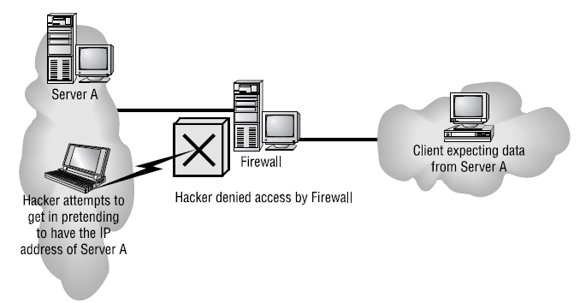
IP Spoofing
IP spoofing is the process of sending packets with a fake source address that makes it look like those packets actually originate from within the network that the hacker is trying to attack.

Slide 9
Active-X Attacks
A fairly new form of attack makes its way to your computer through ActiveX and Java programs (applets). These are miniature programs that run on a web server or that you download to your local machine.
Snoop or spyware programs allow a hacker to look at everything on your hard drive from a remote location without you knowing about it, which is really bad; so be sure you properly configure the on-access component of your antivirus software to check and clean for these types of attacks.

Slide 10
Backdoors
Backdoors are simply paths leading into a computer or network. From simple invasions to elaborate Trojan Horses, villains can use their previously placed inroads into a specific host or a network whenever they want to. That is, unless you can detect them and stop them in their tracks.

Slide 11
Password Attacks
Password attacks come in many flavors. Even though they can be achieved via more sophisticated types of attacks like IP spoofing, packet sniffing, and Trojan Horses, their sole purpose is to (surprise!) discover user passwords so the thief can pretend they’re a valid user and then access that user’s privileges and resources.

Slide 12
Brute-Force Attacks
A brute-force attack is another software-oriented attack that employs a program running on a targeted network that tries to log in to some type of shared network resource like a server. For the hacker, it’s ideal if the accessed accounts have a lot of privileges because then the bad guys can form backdoors to use for gaining access later and bypass the need for passwords entirely.

Slide 13
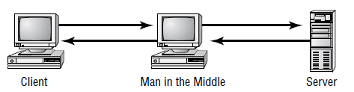
Man-in-the-Middle Attacks
A man-in-the-middle attack happens when someone intercepts packets intended for one computer and reads the data. A common guilty party could be someone working for your very own ISP using a packet sniffer and augmenting it with routing and transport protocols. Rogue ATM machines and even credit-card swipers are tools also increasingly used for this type of attack.

Slide 14
Rogue Access Points
A rogue access point is one that’s been installed on a network without the administrator’s knowledge. These can be unintentional—when a user innocently plugs a wireless router or wireless access point in to the end of a network cable in your building it is clearly unsecured, and so it’s rogue. Of course, not all users—even valid ones on your network—are innocent, and they can also hook things up on purpose to facilitate an easy attack. Rogue access points are very useful to someone who wants to set up a man-in-the-middle attack.

Slide 15
Social Engineering (Phishing)
Social engineering, or phishing, refers to the act of attempting to illegally obtain sensitive information by pretending to be a credible source. Common phishing tactics include emails, phone calls, or even starting up a conversation in person.
The golden rule is, don’t ever give any of your information or anyone else’s to anyone you’re not absolutely sure should have it. And if they are someone who should have it, they probably already do, and they shouldn’t be contacting you for it!

Slide 16
Understanding Mitigation Techniques
There are three main ways to detect an intruder and defend yourself against one:
  Active detection, which involves constantly scanning the network for possible break-ins
  Passive detection, which involves logging all network events to a file
  Proactive defense methods, which involve using tools to shore up your network walls against attack

Slide 17
Policies and Procedures
Every company should have written policies to effectively enable security on their computer networks. These policies should have the approval of the highest-ranking security or IT officer within the company, and they should address all aspects of the company network. Procedures should also be in place to determine the appropriate course of action in the event that there is a security breach. And all network administrators absolutely need to be thoroughly trained on all policies and procedures—no weak links.

Slide 18
Clean-Desk Policy
That clean-desk policy doesn’t just end with “get rid of the crumbs from your last snack”; it means requiring that all potentially important documents like books, schematics, confidential letters, notes to self, and so on aren’t left out in the open when someone’s away from their desk. Instead, they’re locked away, securely out of sight. And make sure it’s clear that this rule applies to users’ PC desktops, too. Policies like this apply to offices, laboratories, and workbenches as well as desks, and it’s really important for employees who share workspaces and/or workstations.

Slide 19
Recording Equipment
Any recording equipment, like tape recorders, cell phones, and small-memory devices like USB flash memory keychains, can contain sensitive, confidential information, so a good security policy should prohibit their unauthorized presence and use.

Slide 20
The Exit Interview
When an employee leaves the company—whether they’re quitting to move on to another job or being terminated—all company property needs to be turned in and logged. This includes things like company cell phones, pagers, toolkits, keys, badges, security tokens, models, and, obviously, all company documents.
And clearly, IT needs to disable all accounts immediately, including those for network access and voice mail, and remaining employees should be informed that the employee is leaving at this time as well.

Slide 21
Security Procedures
A security procedure defines how to respond to any security event that happens on your network.
  What to do when someone has locked themselves o ut of their account
  How to properly install or remove software on servers
  What to do if files on the servers suddenly appear to be “missing” or altered
  How to respond when a network computer has a virus
  Actions to take if it appears that a hacker has broken into the network
  Actions to take if there is a physical emergency such as a fire or flood

Slide 22
Patches and Upgrades
As operating systems and applications are released, their developers have a chance to catch and repair the problems they uncover. In addition, as hackers find and take advantage of vulnerabilities, software developers work to plug those holes. The repairs are usually released to the public as patches or hot fixes. To address large-scale issues or add major features and components to the program, companies release complete upgrades instead.

Slide 23
Updating Antivirus Components
For your antivirus program to work for you, you’ve got to upgrade, update, and scan in a specific order:
  Upgrade the antivirus engine.
  Update the definition files.
  Create an antivirus emergency boot disk.
  Configure and run a full on-demand scan.
  Schedule monthly full on-demand scans.
  Configure and activate on-access scans.
  Make a new antivirus emergency boot disk monthly.
  Get the latest update when fighting a virus outbreak.
  Repeat all steps when you get a new engine.

Slide 24
Fixing an Infected Computer
  We talked about the dark side of computer networking: bad guys and the threats and attacks they use to victimize our systems and networks. You learned a lot about tactics like denial of service attacks, viruses, worms, social engineering, and other devious methods that hackers use. After that, you learned about ways to mitigate these threats and protect yourself by establishing policies and procedures, providing training, and ensuring that all your software is up to date. You also learned what to do about the ubiquitous problem of viruses.

